Slide 1

COMPUTER ORGANISATION (TỔ CHỨC MÁY TÍNH)
Number Systems and Codes

Slide 2
Acknowledgement
The contents of these slides have origin from School of Computing, National University of Singapore.
We greatly appreciate support from Mr. Aaron Tan Tuck Choy for kindly sharing these materials.

Slide 3
Policies for students
These contents are only used for students PERSONALLY.
Students are NOT allowed to modify or deliver these contents to anywhere or anyone for any purpose.

Slide 4
Recording of modifications
Delete slide QUICK REVIEW QUESTIONS

Slide 5
NUMBER SYSTEMS & CODES
Information Representations
Number Systems
Base Conversion
Negative Numbers
Excess Representation
Floating-Point Numbers
Decimal codes: BCD, Excess-3, 2421, 84-2-1
Gray Code
Alphanumeric Code
Error Detection and Correction
Read up DLD for details!

Slide 6
INFORMATION REPRESENTATION (1/3)
Numbers are important to computers
Represent information precisely
Can be processed
Examples
Represent yes or no: use 0 and 1
Represent the 4 seasons: 0, 1, 2 and 3
Sometimes, other characters are used
Matriculation number: 8 alphanumeric characters (eg: U071234X)

Slide 7

INFORMATION REPRESENTATION (2/3)
Bit (Binary digit)
0 and 1
Represent false and true in logic
Represent the low and high states in electronic devices
Other units
Byte: 8 bits
Nibble: 4 bits (seldom used)
Word: Multiples of byte (eg: 1 byte, 2 bytes, 4 bytes, 8 bytes, etc.), depending on the architecture of the computer system

Slide 8
INFORMATION REPRESENTATION (3/3)
N bits can represent up to 2^{N} values.
Examples:
2 bits 🡪 represent up to 4 values (00, 01, 10, 11)
3 bits 🡪 rep. up to 8 values (000, 001, 010, …, 110, 111)
4 bits 🡪 rep. up to 16 values (0000, 0001, 0010, …., 1111)
To represent M values, ⎡log₂M⎤ bits are required.
Examples:
32 values 🡪 requires 5 bits
64 values 🡪 requires 6 bits
1024 values 🡪 requires 10 bits
40 values 🡪 how many bits?
100 values 🡪 how many bits?

Slide 9
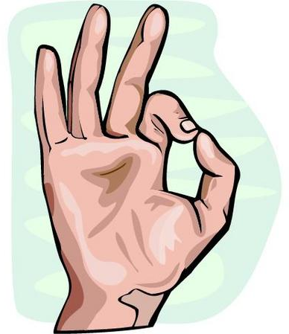
DECIMAL (BASE 10) SYSTEM (1/2)
A weighted-positional number system
Base or radix is 10 (the base or radix of a number system is the total number of symbols/digits allowed in the system)
Symbols/digits = { 0, 1, 2, 3, 4, 5, 6, 7, 8, 9 }
Position is important, as the value of each symbol/digit is dependent on its type and its position in the number
Example, the 9 in the two numbers below has different values:
(7594)₁₀ = (7 × 10³) + (5 × 10²) + (9 × 10¹) + (4 × 10⁰)
(912)₁₀ = (9 × 10²) + (1 × 10¹) + (2 × 10⁰)
In general,
(a_{n}a_{n-1}… a₀ . f₁f₂ … f_{m})₁₀ = (a_{n} x 10^{n}) + (a_{n-1}x10^{n-1}) + … + (a₀ x 10⁰) + (f₁ x 10⁻¹) + (f₂ x 10⁻²) + … + (f_{m} x 10^{-m})

Slide 10
DECIMAL (BASE 10) SYSTEM (2/2)
Weighing factors (or weights) are in powers of 10:
… 10³ 10² 10¹ 10⁰ . 10⁻¹ 10⁻² 10⁻³ …
To evaluate the decimal number 593.68, the digit in each position is multiplied by the corresponding weight:
5×10² + 9×10¹ + 3×10⁰ + 6×10⁻¹ + 8×10⁻² = (593.68)₁₀

Slide 11
OTHER NUMBER SYSTEMS (1/2)
Binary (base 2)
Weights in powers of 2
Binary digits (bits): 0, 1
Octal (base 8)
Weights in powers of 8
Octal digits: 0, 1, 2, 3, 4, 5, 6, 7.
Hexadecimal (base 16)
Weights in powers of 16
Hexadecimal digits: 0, 1, 2, 3, 4, 5, 6, 7, 8, 9, A, B, C, D, E, F.
Base/radix R:
Weights in powers of R

Slide 12
OTHER NUMBER SYSTEMS (2/2)
In some programming languages/software, special notations are used to represent numbers in certain bases
In programming language C
Prefix 0 for octal. Eg: 032 represents the octal number (32)₈
Prefix 0x for hexadecimal. Eg: 0x32 represents the hexadecimal number (32)₁₆
In PCSpim (a MIPS simulator)
Prefix 0x for hexadecimal. Eg: 0x100 represents the hexadecimal number (100)₁₆
In Verilog, the following values are the same
8’b11110000: an 8-bit binary value 11110000
8’hF0: an 8-bit binary value represented in hexadecimal F0
8’d240: an 8-bit binary value represented in decimal 240

Slide 13
BASE-R TO DECIMAL CONVERSION
Easy!
1101.101₂ = 1×2³ + 1×2² + 1×2⁰ + 1×2⁻¹ + 1×2⁻³
572.6₈ =
2A.8₁₆ =
341.24₅ =
◈
Notes:
https://www.rapidtables.com/convert/number/octal-to-decimal.html

Slide 14
DECIMAL TO BINARY CONVERSION
Method 1
Sum-of-Weights Method
Method 2
Repeated Division-by-2 Method (for whole numbers)
Repeated Multiplication-by-2 Method (for fractions)

Slide 15
SUM-OF-WEIGHTS METHOD
Determine the set of binary weights whose sum is equal to the decimal number
(9)₁₀ = 8 + 1 = 2³ + 2⁰ = (1001)₂
(18)₁₀ = 16 + 2 = 2⁴ + 2¹ = (10010)₂
(58)₁₀ = 32 + 16 + 8 + 2 = 2⁵ + 2⁴ + 2³ + 2¹ = (111010)₂
(0.625)₁₀ = 0.5 + 0.125 = 2⁻¹ + 2⁻³ = (0.101)₂

Slide 16
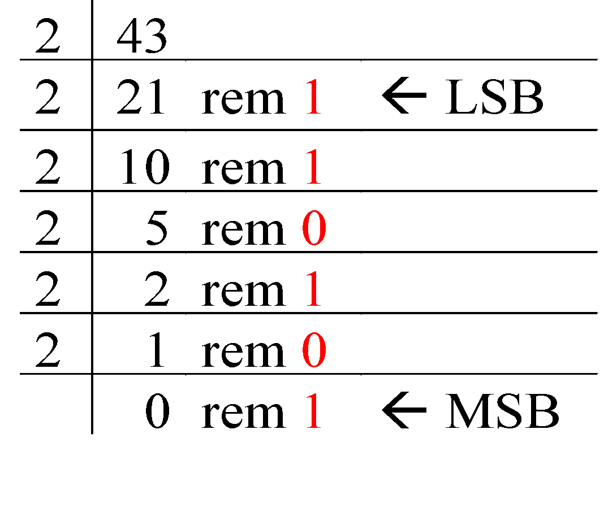
REPEATED DIVISION-BY-2
To convert a whole number to binary, use successive division by 2 until the quotient is 0. The remainders form the answer, with the first remainder as the least significant bit (LSB) and the last as the most significant bit (MSB).
(43)₁₀ = (101011)₂

Slide 17
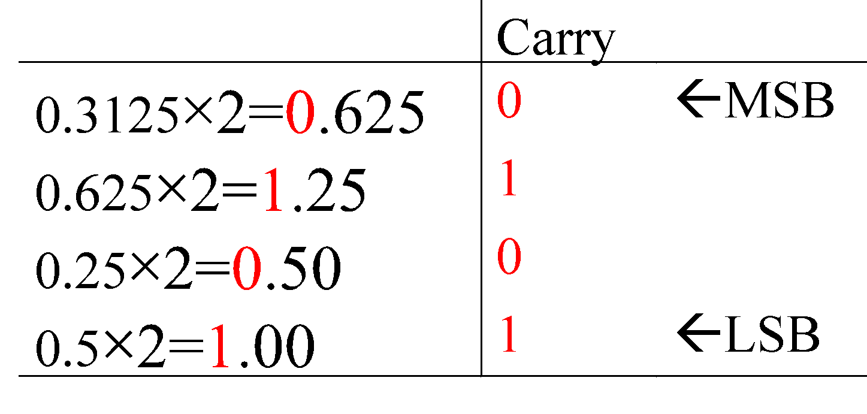
REPEATED MULTIPLICATION-BY-2
To convert decimal fractions to binary, repeated multiplication by 2 is used, until the fractional product is 0 (or until the desired number of decimal places). The carried digits, or carries, produce the answer, with the first carry as the MSB, and the last as the LSB.
(0.3125)₁₀ = (.0101)₂

Slide 18
CONVERSION BETWEEN DECIMAL AND OTHER BASES
Base-R to decimal: multiply digits with their corresponding weights.
Decimal to binary (base 2)
Whole numbers repeated division-by-2
Fractions: repeated multiplication-by-2
Decimal to base-R
Whole numbers: repeated division-by-R
Fractions: repeated multiplication-by-R

Slide 19
CONVERSION BETWEEN BASES
In general, conversion between bases can be done via decimal:
Base-2 Base-2
Base-3 Base-3
Base-4 Decimal Base-4
… ….
Base-R Base-R
Shortcuts for conversion between bases 2, 4, 8, 16 (see next slide)

Slide 20
BINARY TO OCTAL/HEXADECIMAL CONVERSION
Binary 🡪 Octal: partition in groups of 3
(10 111 011 001 . 101 110)₂ =
Octal 🡪 Binary: reverse
(2731.56)₈ =
Binary 🡪 Hexadecimal: partition in groups of 4
(101 1101 1001 . 1011 1000)₂ =
Hexadecimal 🡪 Binary: reverse
(5D9.B8)₁₆ =
◈

Slide 21
PEEKING AHEAD (1/2)
Function simplification (eg: Quine-McCluskey)
In ‘computer-speak’, units are in powers of 2
Memory addressing (see next slide)
◈

Slide 22
PEEKING AHEAD (2/2)
Memory addressing
Assume 2¹⁰ bytes in memory, and each word contains 4 bytes.
Addresses
Memory
binary
decimal
0000000000
0000000001
0000000010
0000000011
0000000100
0000000101
0000000110
0000000111
0000001000
0000001001
0000001010
0000001011
.
.
1111111111
0
1
2
3
4
5
6
7
8
9
10
11
.
.
1023
0 0 1 0 1 1 0 1
0 1 0 1 0 1 0 1
1 0 1 1 1 1 0 0
0 1 1 1 1 0 0 1
1 1 0 0 1 1 0 0
1 0 0 0 0 1 0 1
1 1 0 1 0 1 1 1
0 0 0 1 1 0 0 0
0 1 1 0 1 1 0 1
1 0 0 1 1 0 1 1
1 1 0 1 0 1 0 1
0 1 0 0 0 0 0 1
⬤
⬤
⬤
◈

Slide 23
NEGATIVE NUMBERS
Unsigned numbers: only non-negative values.
Signed numbers: include all values (positive and negative)
There are 3 common representations for signed binary numbers:
Sign-and-Magnitude
1s Complement
2s Complement

Slide 24
SIGN-AND-MAGNITUDE (1/3)
The sign is represented by a ‘sign bit’
0 for +
1 for -
Eg: a 1-bit sign and 7-bit magnitude format.
sign
magnitude
00110100 🡺 +110100₂ = ?
10010011 🡺 -10011₂ = ?
◈

Slide 25
SIGN-AND-MAGNITUDE (2/3)
Largest value: 01111111 = +127₁₀
Smallest value: 11111111 = -127₁₀
Zeros: 00000000 = +0₁₀ 10000000 = -0₁₀
Range: -127₁₀ to +127₁₀
Question:
For an n-bit sign-and-magnitude representation, what is the range of values that can be represented?

Slide 26
SIGN-AND-MAGNITUDE (3/3)
To negate a number, just invert the sign bit.
Examples:
How to negate 00100001_{sm} (decimal 33)? Answer: 10100001_{sm} (decimal -33)
How to negate 10000101_{sm} (decimal -5)? Answer: 00000101_{sm} (decimal +5)

Slide 27
1s COMPLEMENT (1/3)
Given a number x which can be expressed as an n-bit binary number, its negated value can be obtained in 1s-complement representation using:
-x = 2^{n} – x – 1
Example: With an 8-bit number 00001100 (or 12₁₀), its negated value expressed in 1s-complement is:
-00001100₂ = 2⁸ – 12 – 1 (calculation in decimal) = 243 = 11110011_{1s}
(This means that -12₁₀ is written as 11110011 in 1s-complement representation.)

Slide 28
1s COMPLEMENT (2/3)
Essential technique to negate a value: invert all the bits.
Largest value: 01111111 = +127₁₀
Smallest value: 10000000 = -127₁₀
Zeros: 00000000 = +0₁₀ 11111111 = -0₁₀
Range: -127₁₀ to +127₁₀
The most significant (left-most) bit still represents the sign: 0 for positive; 1 for negative.

Slide 29
1s COMPLEMENT (3/3)
Examples (assuming 8-bit numbers):
(14)₁₀ = (00001110)₂ = (00001110)_{1s}
-(14)₁₀ = -(00001110)₂ = (11110001)_{1s}
-(80)₁₀ = -( ? )₂ = ( ? )_{1s}

Slide 30
2s COMPLEMENT (1/3)
Given a number x which can be expressed as an n-bit binary number, its negated value can be obtained in 2s-complement representation using:
-x = 2^{n} – x
Example: With an 8-bit number 00001100 (or 12₁₀), its negated value expressed in 2s-complement is:
-00001100₂ = 2⁸ – 12 (calculation in decimal) = 244 = 11110100_{2s}
(This means that -12₁₀ is written as 11110100 in 2s-complement representation.)

Slide 31
2s COMPLEMENT (2/3)
Essential technique to negate a value: invert all the bits, then add 1.
Largest value: 01111111 = +127₁₀
Smallest value: 10000000 = -128₁₀
Zero: 00000000 = +0₁₀
Range: -128₁₀ to +127₁₀
The most significant (left-most) bit still represents the sign: 0 for positive; 1 for negative.

Slide 32
2s COMPLEMENT (3/3)
Examples (assuming 8-bit numbers):
(14)₁₀ = (00001110)₂ = (00001110)_{2s}
-(14)₁₀ = -(00001110)₂ = (11110010)_{2s}
-(80)₁₀ = -( ? )₂ = ( ? )_{2s}
Compare with slide 30.
1s complement:
(14)₁₀ = (00001110)₂ = (00001110)_{1s}
-(14)₁₀ = -(00001110)₂ = (11110001)_{1s}

Slide 33

READING ASSIGNMENT
Download from the course website and read the Supplement Notes on Lecture 2: Number Systems.
Work out the exercises in there and discuss them in the IVLE forum if you have doubts.

Slide 34
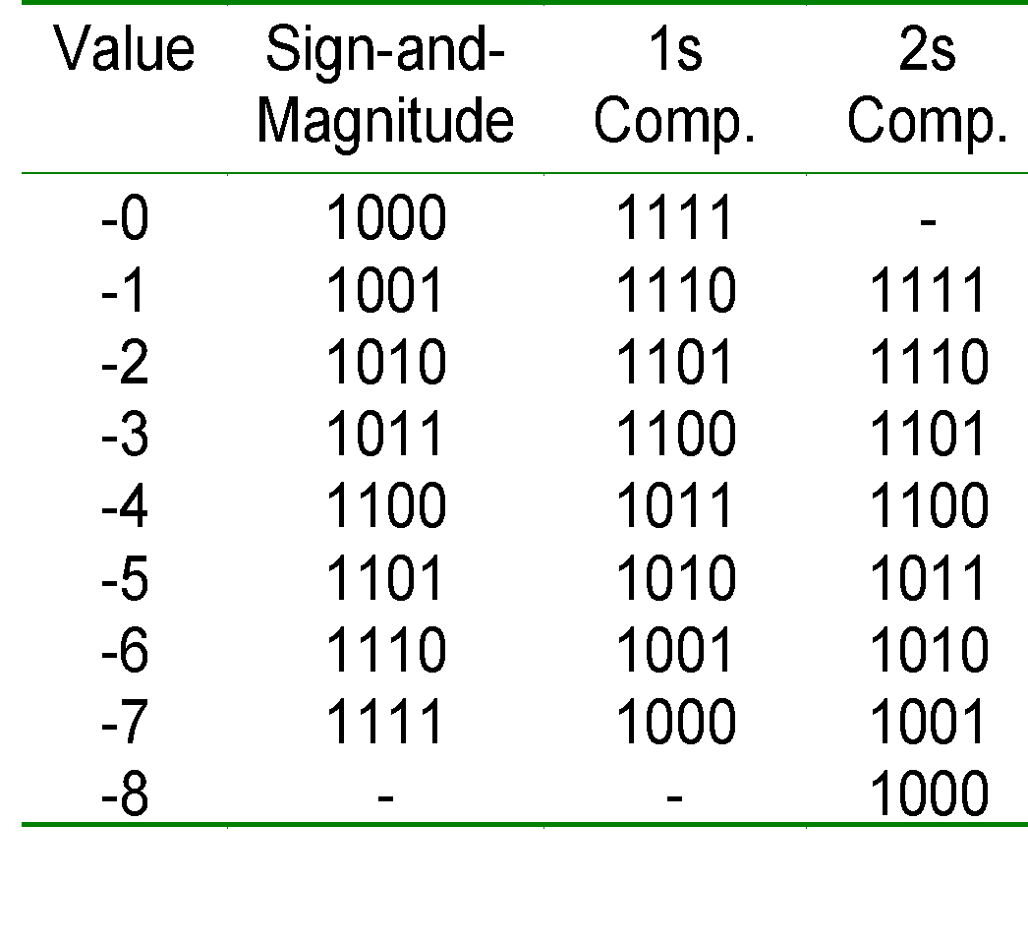
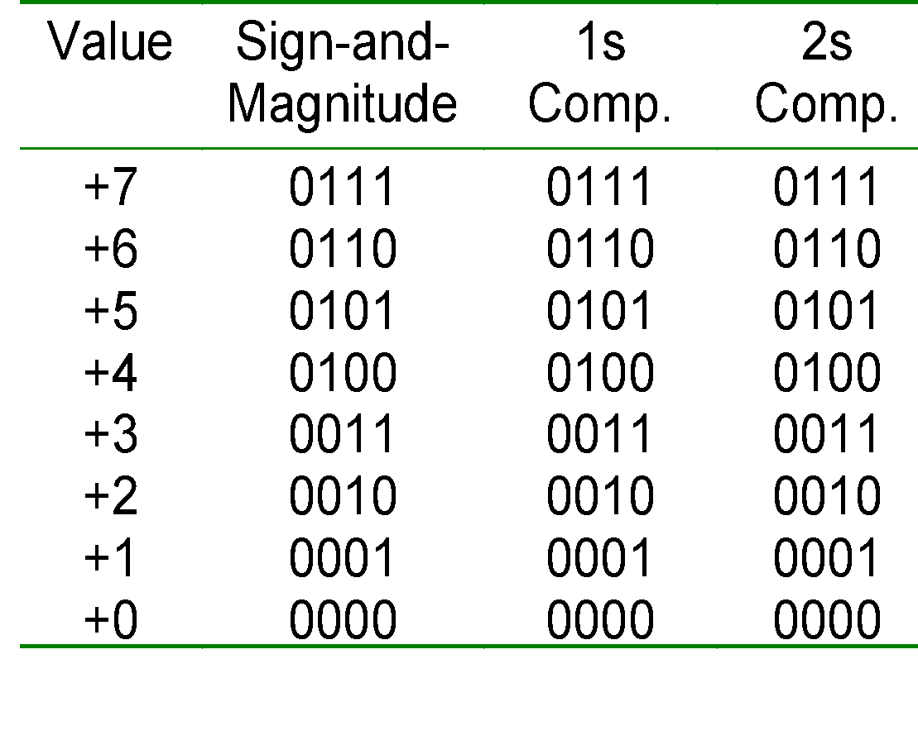
COMPARISONS
Important!
4-bit system
Positive values Negative values

Slide 35
COMPLEMENT ON FRACTIONS
We can extend the idea of complement on fractions.
Examples:
Negate 0101.01 in 1s-complement Answer: 1010.10
Negate 111000.101 in 1s-complement Answer: 000111.010
Negate 0101.01 in 2s-complement Answer: 1010.11

Slide 36
2s COMPLEMENT ADDITION/SUBTRACTION (1/3)
Algorithm for addition, A + B:
Perform binary addition on the two numbers.
Ignore the carry out of the MSB.
Check for overflow. Overflow occurs if the ‘carry in’ and ‘carry out’ of the MSB are different, or if result is opposite sign of A and B.
Algorithm for subtraction, A – B: A – B = A + (-B)
Take 2s-complement of B.
Add the 2s-complement of B to A.

Slide 37
OVERFLOW
Signed numbers are of a fixed range.
If the result of addition/subtraction goes beyond this range, an overflow occurs.
Overflow can be easily detected:
positive add positive 🡪 negative
negative add negative 🡪 positive
Example: 4-bit 2s-complement system
Range of value: -8₁₀ to 7₁₀
0101_{2s} + 0110_{2s} = 1011_{2s} 5₁₀ + 6₁₀ = -5₁₀ ?! (overflow!)
1001_{2s} + 1101_{2s} = 10110_{2s} (discard end-carry) = 0110_{2s} -7₁₀ + -3₁₀ = 6₁₀ ?! (overflow!)

Slide 38
2s COMPLEMENT ADDITION/SUBTRACTION (2/3)
Examples: 4-bit system
+3 0011
+ +4 + 0100
---- -------
+7 0111
---- -------
-2 1110
+ -6 + 1010
---- -------
-8 11000
---- -------
+6 0110
+ -3 + 1101
---- -------
+3 10011
---- -------
+4 0100
+ -7 + 1001
---- -------
-3 1101
---- -------
Which of the above is/are overflow(s)?
◈

Slide 39
2s COMPLEMENT ADDITION/SUBTRACTION (3/3)
Examples: 4-bit system
-3 1101
+ -6 + 1010
---- -------
-9 10111
---- -------
+5 0101
+ +6 + 0110
---- -------
+11 1011
---- -------
Which of the above is/are overflow(s)?
◈

Slide 40
1s COMPLEMENT ADDITION/SUBTRACTION (1/2)
Algorithm for addition, A + B:
Perform binary addition on the two numbers.
If there is a carry out of the MSB, add 1 to the result.
Check for overflow. Overflow occurs if result is opposite sign of A and B.
Algorithm for subtraction, A – B: A – B = A + (-B)
Take 1s-complement of B.
Add the 1s-complement of B to A.

Slide 41
1s COMPLEMENT ADDITION/SUBTRACTION (2/2)
Any overflow?
Examples: 4-bit system
+3 0011
+ +4 + 0100
---- -------
+7 0111
---- -------
+5 0101
+ -5 + 1010
---- -------
-0 1111
---- -------
-2 1101
+ -5 + 1010
---- ------
-7 10111
---- + 1
------
1000
-3 1100
+ -7 + 1000
---- -------
-10 10100
---- + 1
-------
0101

Slide 42

QUICK REVIEW QUESTIONS (4)
DLD pages 42 - 43 Questions 2-13 to 2-18.

Slide 43
EXCESS REPRESENTATION (1/2)
Besides sign-and-magnitude and complement schemes, the excess representation is another scheme.
It allows the range of values to be distributed evenly between the positive and negative values, by a simple translation (addition/subtraction).
Example: Excess-4 representation on 3-bit numbers. See table on the right.
Excess-4 Representation | Value
000 | -4
001 | -3
010 | -2
011 | -1
100 | 0
101 | 1
110 | 2
111 | 3
Questions: What if we use Excess-2 on 3-bit numbers? Excess-7?

Slide 44
EXCESS REPRESENTATION (2/2)
Example: For 4-bit numbers, we may use excess-7 or excess-8. Excess-8 is shown below. Fill in the values.
Excess-8 Representation | Value
0000 | -8
0001
0010
0011
0100
0101
0110
0111
Excess-8 Representation | Value
1000
1001
1010
1011
1100
1101
1110
1111
◈

Slide 45
FIXED POINT NUMBERS (1/2)
In fixed point representation, the binary point is assumed to be at a fixed location.
For example, if the binary point is at the end of an 8-bit representation as shown below, it can represent integers from -128 to +127.
binary point

Slide 46
FIXED POINT NUMBERS (2/2)
In general, the binary point may be assumed to be at any pre-fixed location.
Example: Two fractional bits are assumed as shown below.
integer part
fraction part
assumed binary point
If 2s complement is used, we can represent values like:
011010.11_{2s} = 26.75₁₀
111110.11_{2s} = -000001.01₂ = -1.25₁₀

Slide 47
FLOATING POINT NUMBERS (1/4)
Fixed point numbers have limited range.
Floating point numbers allow us to represent very large or very small numbers.
Examples: 0.23 × 10²³ (very large positive number) 0.5 × 10⁻³⁷ (very small positive number) -0.2397 × 10⁻¹⁸ (very small negative number)

Slide 48
FLOATING POINT NUMBERS (2/4)
3 parts: sign, mantissa and exponent
The base (radix) is assumed to be 2.
Sign bit: 0 for positive, 1 for negative.
sign
mantissa
exponent
Mantissa is usually in normalised form (the integer part is zero and the fraction part must not begin with zero)
0.01101 × 2⁴ 🡪 normalised 🡪
101011.0110 × 2⁻⁴ 🡪 normalised 🡪
Trade-off:
More bits in mantissa 🡪 better precision
More bits in exponent 🡪 larger range of values
◈

Slide 49
FLOATING POINT NUMBERS (3/4)
Exponent is usually expressed in complement or excess format.
Example: Express -6.5₁₀ in base-2 normalised form -6.5₁₀ = -110.1₂ = -0.1101₂ × 2³
Assuming that the floating-point representation contains 1-bit, 5-bit normalised mantissa, and 4-bit exponent. The above example will be stored as if the exponent is in 1s or 2s complement.
1
11010
0011

Slide 50
FLOATING POINT NUMBERS (4/4)
Example: Express 0.1875₁₀ in base-2 normalised form
0.1875₁₀ = 0.0011₂ = 0.11 × 2⁻²
Assume this floating-point representation:1-bit sign, 5-bit normalised mantissa, and 4-bit exponent.
The above example will be represented as
0
11000
1101
If exponent is in 1’s complement.
0
11000
1110
If exponent is in 2’s complement.
0
11000
0110
If exponent is in excess-8.

Slide 51
DECIMAL CODES
Decimal numbers are favoured by humans. Binary numbers are natural to computers. Hence, conversion is required.
If little calculation is required, we can use some coding schemes to store decimal numbers, for data transmission purposes.
Examples: BCD (or 8421), Excess-3, 84-2-1, 2421, etc.
Each decimal digit is represented as a 4-bit code.
The number of digits in a code is also called the length of the code.

Slide 52
BINARY CODE DECIMAL (BCD) (1/2)
Some codes are unused, like 1010_{BCD}, 1011_{BCD}, … 1111_{BCD}. These codes are considered as errors.
Easy to convert, but arithmetic operations are more complicated.
Suitable for interfaces such as keypad inputs.
Decimal digit | BCD
0 | 0000
1 | 0001
2 | 0010
3 | 0011
4 | 0100
5 | 0101
6 | 0110
7 | 0111
8 | 1000
9 | 1001

Slide 53
BINARY CODE DECIMAL (BCD) (2/2)
Examples of conversion between BCD values and decimal values:
(234)₁₀ = (0010 0011 0100)_{BCD}
(7093)₁₀ = (0111 0000 1001 0011)_{BCD}
(1000 0110)_{BCD} = (86)₁₀
(1001 0100 0111 0010)_{BCD} = (9472)₁₀
Note that BCD is not equivalent to binary
Example: (234)₁₀ = (11101010)₂

Slide 54
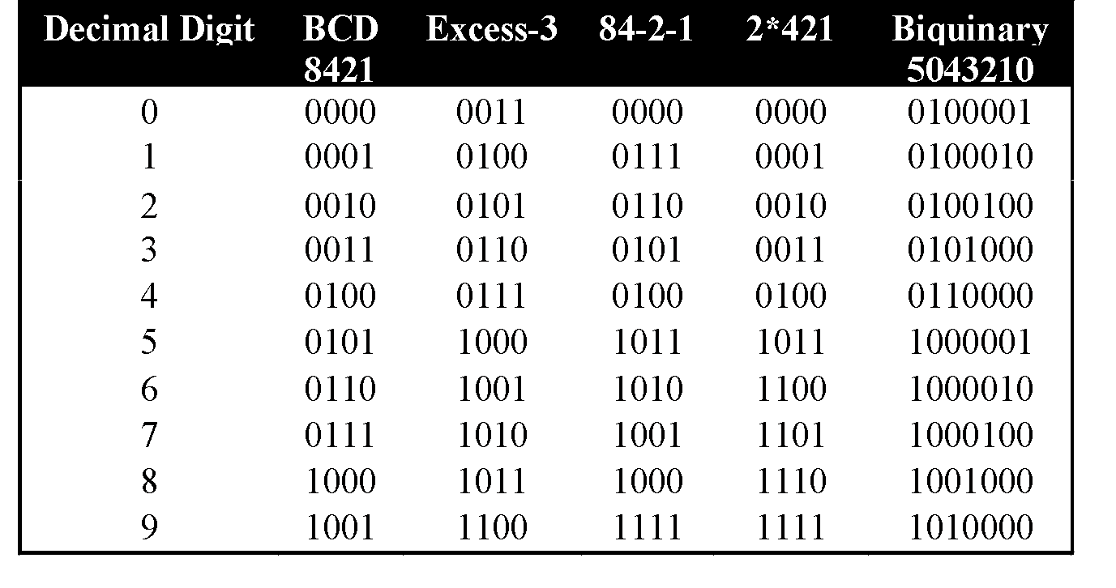
OTHER DECIMAL CODES
Self-complementing code: codes for complementary digits are also complementary to each other.
Error-detecting code: biquinary code (bi=two, quinary=five).

Slide 55
SELF-COMPLEMENTING CODES
The codes representing the pair of complementary digits are also complementary to each other.
Example: Excess-3 code
0: 0011
1: 0100
2: 0101
3: 0110
4: 0111
5: 1000
6: 1001
7: 1010
8: 1011
9: 1100
Question: What are the other self-complementing codes?
◈

Slide 56
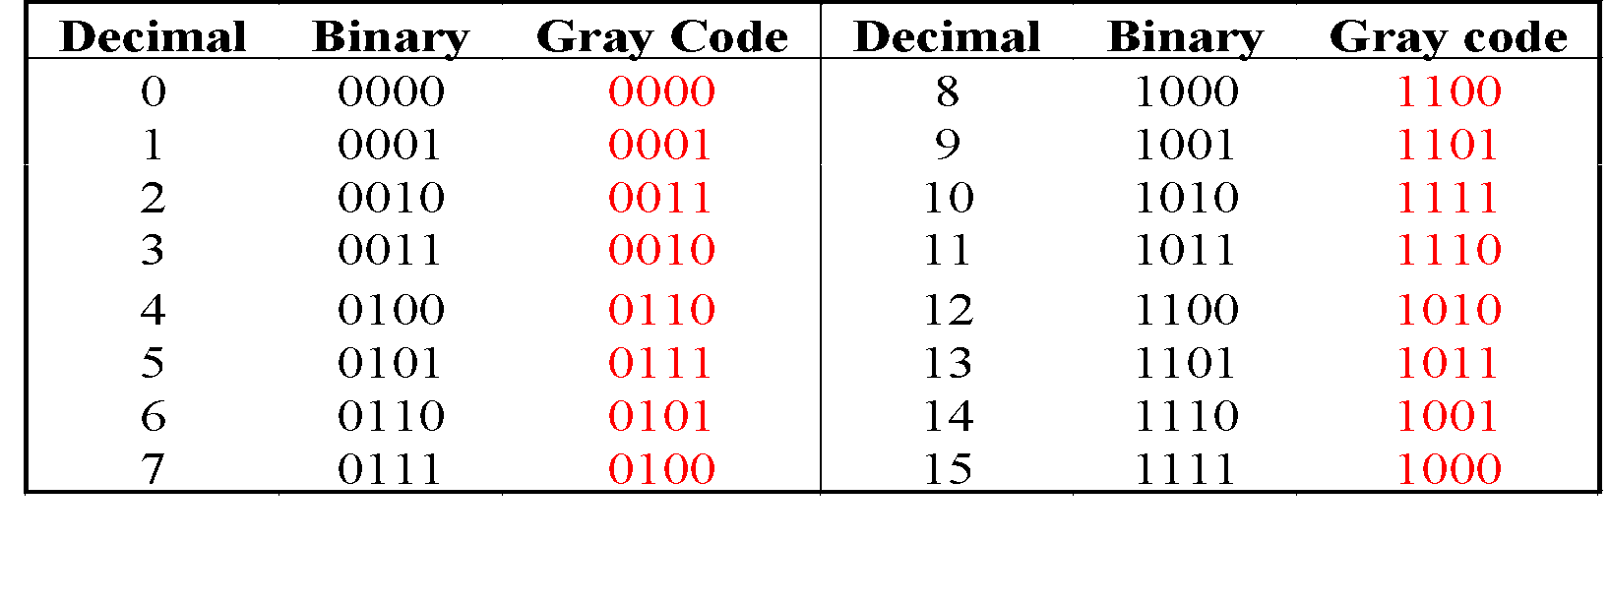
GRAY CODE (1/3)
Unweighted (not an arithmetic code)
Only a single bit change from one code value to the next.
Not restricted to decimal digits: n bits 🡪 2^{n} values.
Good for error detection.
Example: 4-bit standard Gray code

Slide 57
GRAY CODE (2/3)
Generating a 4-bit standard Gray code sequence.
0 0 0 0
0 0 0 1
0 1 0 0
0 1 0 1
0 1 1 1
0 1 1 0
0 0 1 0
0 0 1 1
0 0 0 1
0 0 0 0
1
1
1
1
1
1
1
1
1
1
0 0 0 1
0 0 0 0
0 0 1 0
0 0 1 1
0 0 0 1
0 0 0 0
1
1
1
1
Questions: How to generate 5-bit standard Gray code sequence? 6-bit standard Gray code sequence?

Slide 58
GRAY CODE (3/3)
0 1 1
0 0 1
sensors
0 1 0
0 0 0
1 1 0
1 0 0
1 1 1
1 0 1
mis-aligned sensors
mis-aligned sensors
0 0 1
1 0 0
0 0 1
1 0 0
0 0 1
0 0 0
1 0 0
1 0 1
0 0 0
1 0 1
0 0 0
1 0 1
1 1 1
1 1 1
1 1 1
1 1 1
0 1 0
1 1 1
0 0 0
1 1 1
0 1 0
0 0 0
0 1 0
0 0 0
1 1 0
1 1 0
1 1 0
1 1 0
0 1 1
1 1 0
0 0 1
1 1 0
0 1 1
0 0 1
0 1 1
0 0 1
1 0 1
0 1 0
1 0 1
0 1 0
1 0 0
1 0 1
0 1 1
0 1 0
1 0 0
0 1 1
1 0 0
0 1 1
Binary coded: 111 → 110 → 000
Gray coded: 111 → 101

Slide 59
ALPHANUMERIC CODES (1/3)
Computers also handle textual data.
Character set frequently used:
alphabets: ‘A’ … ‘Z’, ‘a’ … ‘z’
digits: ‘0’ … ‘9’
special symbols: ‘$’, ‘.’, ‘@’, ‘*’, etc.
non-printable: NULL, BELL, CR, etc.
Examples
ASCII (8 bits), Unicode

Slide 60
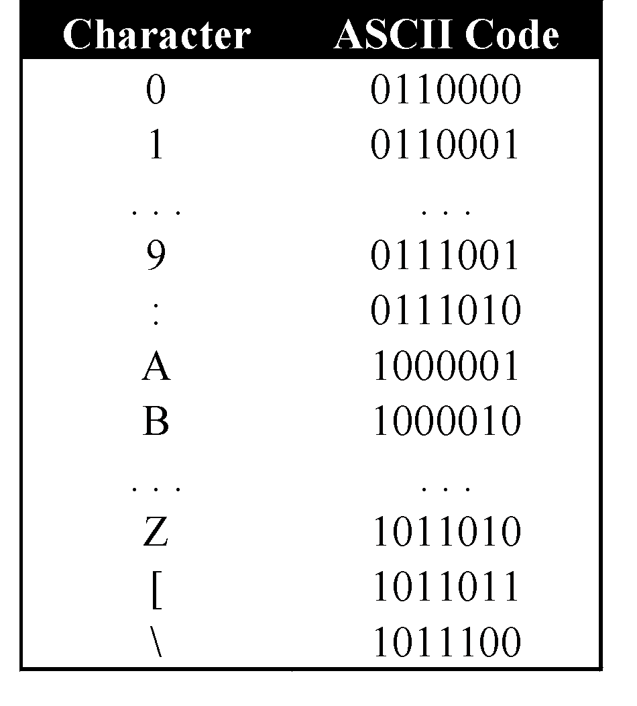
ALPHANUMERIC CODES (2/3)
ASCII
American Standard Code for Information Interchange
7 bits, plus a parity bit for error detection
Odd or even parity

Slide 61
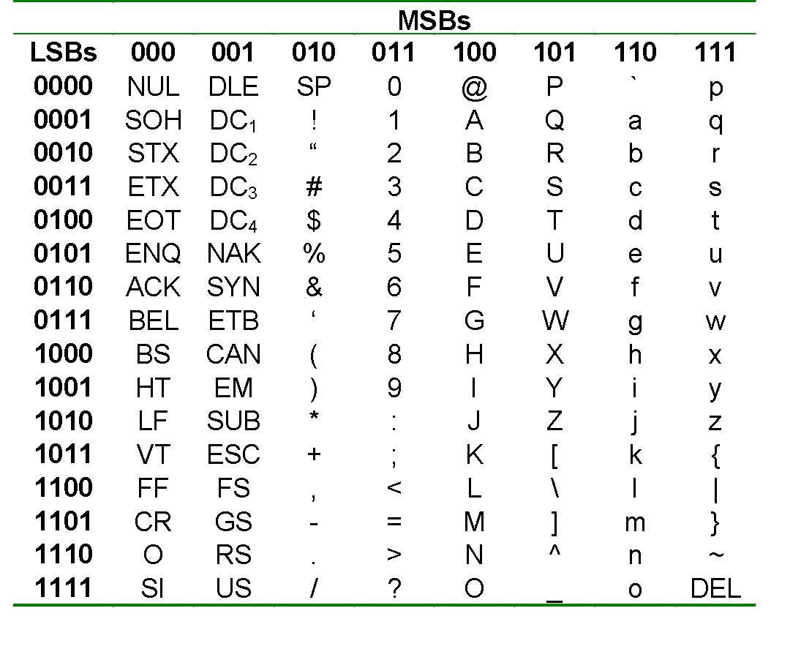
ALPHANUMERIC CODES (3/3)
ASCII table
A: 1000001

Slide 62
ERROR DETECTION (1/4)
Errors can occur during data transmission. They should be detected, so that re-transmission can be requested.
With binary numbers, usually single-bit errors occur.
Example: 0010 erroneously transmitted as 0011 or 0000 or 0110 or 1010.
Decimal digit | Biquinary 5043210
0 | 0100001
1 | 0100010
2 | 0100100
3 | 0101000
4 | 0110000
5 | 1000001
6 | 1000010
7 | 1000100
8 | 1001000
9 | 1010000
Biquinary code has length 7; it uses 3 additional bits for error-detection.

Slide 63
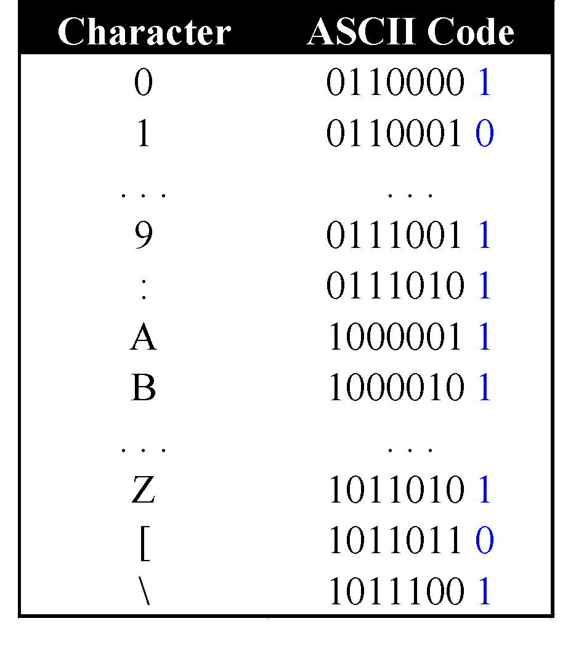
ERROR DETECTION (2/4)
Parity bit
Even parity: additional bit added to make total number of 1’s even.
Odd parity: additional bit added to make total number of 1’s odd.
Example of odd parity on ASCII values.
Parity bits

Slide 64
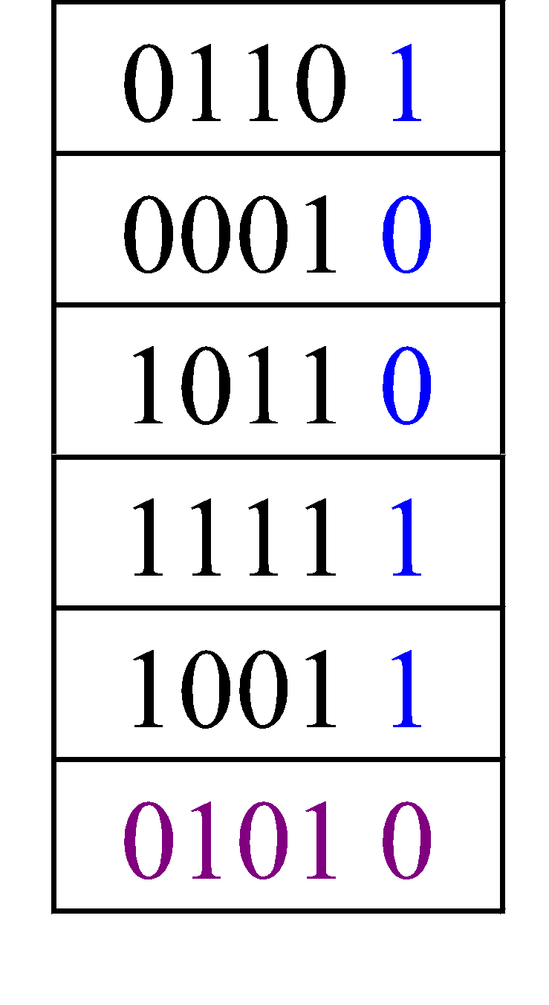
ERROR DETECTION (3/4)
Parity bit can detect odd number of errors but not even number of errors.
Example: Assume odd parity,
10011 🡪 10001 (detected)
10011 🡪 10101 (not detected)
Parity bits can also be applied to a block of data.
Column-wise parity
Row-wise parity

Slide 65
ERROR DETECTION (4/4)
Sometimes, it is not enough to do error detection. We may want to correct the errors.
Error correction is expensive. In practice, we may use only single-bit error correction.
Popular technique: Hamming code

Slide 66
ERROR CORRECTION (1/7)
Given this 3-bit code C₁
{ 000, 110, 011, 101 }
With 4 code words, we actually need only 2 bits.
We call this k, the number of original message bits.
To add error detection/correction ability, we use more bits than necessary.
In this case, the length of each codeword is 3
We define code efficiency (or rate) by
k / length of codeword
Hence, efficiency of C₁ is 2/3.

Slide 67
ERROR CORRECTION (2/7)
Given this 3-bit code C₁
{ 000, 110, 011, 101 }
Can C₁ detect a single bit error?
Can C₁ correct a single bit error?
Sometimes, we use “1 error” for “single bit error”, “2 errors” for “2 bits error”, etc.
◈

Slide 68
ERROR CORRECTION (3/7)
The distance d between any two code words in a code is the sum of the number of differences between the codewords.
Example: d(000, 110) = 2; d(0110,1011) = 3.
The Hamming distance δ of a code is the minimum distance between any two code words in the code.
Example: The Hamming distance of C₁ is 2.
A code with Hamming distance of 2 can detect 1 error.

Slide 69
ERROR CORRECTION (4/7)
Given this 6-bit code C₂
{ 000000, 111000, 001110, 110011 }
What is its efficiency?
What is its Hamming distance?
Can it correct 1 error?
Can it correct 2 errors?
◈

Slide 70
ERROR CORRECTION (5/7)
Self-study
Hamming code: a popular error-correction code
Procedure
Parity bits are at positions that are powers of 2 (i.e. 1, 2, 4, 8, 16, …)
All other positions are data bits
Each parity bit checks some of the data bits
Position 1: Check 1 bit, skip 1 bit (1, 3, 5, 7, 9, 11, …)
Position 2: Check 2 bits, skip 2 bits (2, 3, 6, 7, 10, 11, …)
Position 4: Check 4 bits, skip 4 bits (4-7, 12-15, 20-23, …)
Position 8: Check 8 bits, skip 8 bits (8-15, 24-31, 40-47, …)
Set the parity bit accordingly so that total number of 1s in the positions it checks is even.

Slide 71
ERROR CORRECTION (6/7)
Self-study
Example: Data 10011010
Insert positions for parity bits:
_ _ 1 _ 0 0 1 _ 1 0 1 0
Position 1: ? _ 1 _ 0 0 1 _ 1 0 1 0 🡪 so ? must be 0
Position 2: 0 ? 1 _ 0 0 1 _ 1 0 1 0 🡪 so ? must be 1
Position 4: 0 1 1 ? 0 0 1 _ 1 0 1 0 🡪 so ? must be 1
Position 8: 0 1 1 1 0 0 1 ? 1 0 1 0 🡪 so ? must be 0
Answer: 0 1 1 1 0 0 1 0 1 0 1 0

Slide 72
ERROR CORRECTION (7/7)
Self-study
Suppose 1 error occurred and the received data is:
0 1 1 1 0 0 1 0 1 1 1 0
How to determine which bit is in error?
Check which parity bits are in error.
Answer: parity bits 2 and 8.
Add the positions of these erroneous parity bits
Answer: 2 + 8 = 10. Hence data bit 10 is in error.
Corrected data: 0 1 1 1 0 0 1 0 1 0 1 0

Slide 73
READING ASSIGNMENT
Conversion between standard Gray code and binary
DLD page 1-24.

Slide 74
Q&A

